Slide 1


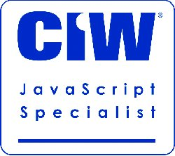
React.js Stack – Section 01
Mark J. Buckler
OCPJP,CIWJS

Slide 2

Credits
Some of the contents of this slide presentation have been referenced and reproduced, from Learning Full-Stack JavaScript Development: MongoDB, Node, and React , by Samer Buna, ©2018 LinkedIn Corporation.

Slide 3
LEARNING OBJECTIVES
Set Up the Application and Dependencies
Build a Server for the Application with ExpressJS
Setting Up the Views with EJS

Slide 4

React.js
Programming Exercise07_01_01 – Step 1
Set Up the Application and Dependencies

Slide 5
React.js
Programming Exercise07_01_01 – Step 2
Build a Server for the Application with ExpressJS

Slide 6
React.js
Programming Exercise07_01_01 – Step 3
Setting Up the Views with EJS

